Slide 1

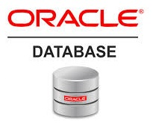
Oracle database
Lecture 34

Slide 2

Today’s Agenda
Obtaining Details Of Privileges
Obtaining Details About Roles
Examples
Synonyms
Types Of Synonyms
Dropping And Renaming Synonyms

Slide 3
Obtaining Details About Privileges
USER_SYS_PRIVS: It contains the information about system privileges assigned to the current user.
It contains following columns
USERNAME
PRIVILEGE
ADMIN_OPTION

Slide 4
Obtaining Details About Privileges
USER_TAB_PRIVS: It contains the information about object privileges assigned to a user or by the user.
It contains following columns
OWNER
GRANTEE
GRANTOR
TABLE_NAME
PRIVILEGE
GRANTABLE

Slide 5
Obtaining Details About Privileges
USER_TAB_PRIVS_MADE: It contains the information about object privileges assigned by the user.
It contains following columns
OWNER
GRANTEE
GRANTOR
TABLE_NAME
PRIVILEGE
GRANTABLE

Slide 6
Obtaining Details About Privileges
USER_TAB_PRIVS_RECD: It contains the information about object privileges assigned to the user
It contains following columns
GRANTOR
TABLE_NAME
PRIVILEGE
GRANTABLE

Slide 7
Obtaining Details About Roles
ROLE_SYS_PRIVS: It contains the information about system privileges received through a role.
It contains following columns
ROLE
PRIVILEGE
ADMIN_OPTION

Slide 8
Obtaining Details About Privileges
DBA_TAB_PRIVS: It is the base table for all the previous three views i.e. USER_TAB_PRIVS , USER_TAB_PRIVS_MADE and USER_TAB_PRIVS_RECD and can only be accessed by logging in from System user.
It contains the information about privileges related to every user in the database.
It contains following columns
GRANTEE
GRANTOR
TABLE_NAME
PRIVILEGE
GRANTABLE

Slide 9
Obtaining Details About Roles
USER_ROLE_PRIVS: It contains information about the roles of a user.
It contains following columns
USERNAME
GRANTED_ROLE
ADMIN_OPTION

Slide 10
Obtaining Details About Roles
DBA_ROLES: It contains the names of all the roles and has a column called ROLE.
DBA_ROLE_PRIVS: It contains information about the roles of a user as well as other roles.
It contains following columns
GRANTEE
GRANTED_ROLE
ADMIN_OPTION

Slide 11
Obtaining Details About Privileges & Roles
DBA_SYS_PRIVS: It contains information about system privileges assigned to a user as well as roles
It contains following columns
GRANTEE
PRIVILEGE
ADMIN_OPTION

Slide 12
Obtaining Details About Privileges
ROLE_TAB_PRIVS: It contains information about object privileges assigned to a role.
It contains following columns
ROLE
OWNER
TABLE_NAME
COLUMN_NAME
PRIVILEGE
GRANTABLE

Slide 13
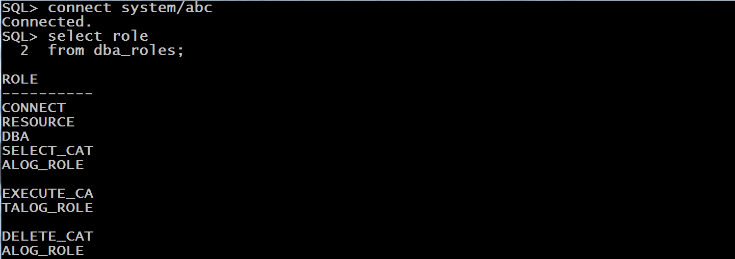
Example
WAQ to display all the roles in Oracle.

Slide 14
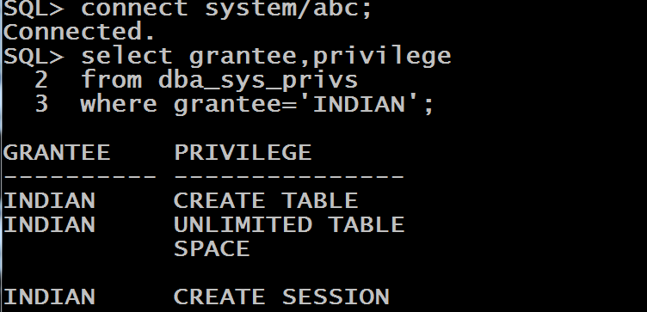
Example
WAQ to display all the system privileges held by the user INDIAN.

Slide 15
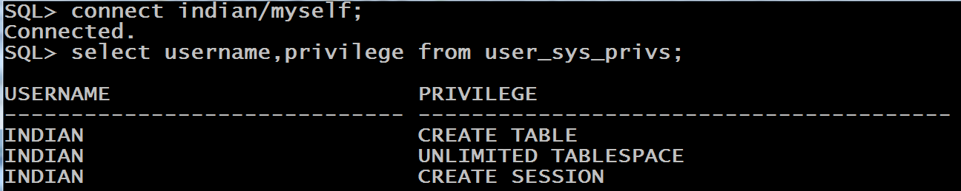
Example
WAQ to display all the system privileges held by the user INDIAN.

Slide 16
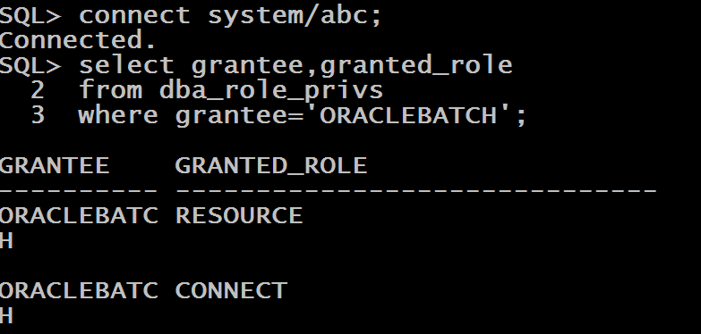
Example
WAQ to display all the roles held by the user ORACLEBATCH.

Slide 17
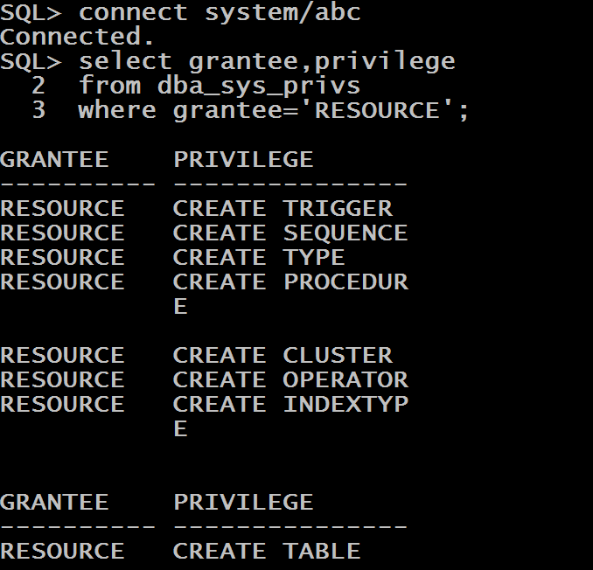
Example
WAQ to display all the privileges stored inside the role RESOURCE.

Slide 18
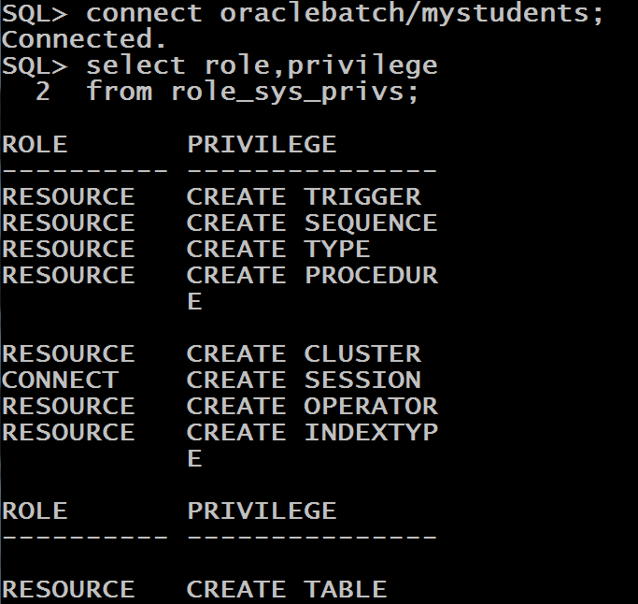
Example
WAQ to display all the system privileges which the user ORACLEBATCH has received through roles.

Slide 19
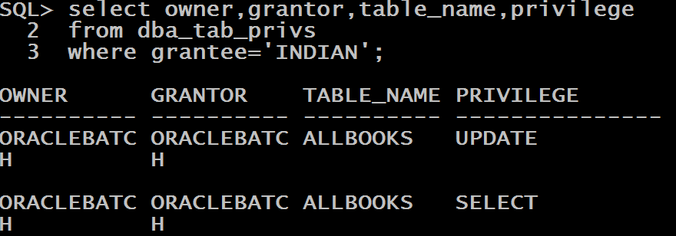
Example
WAQ to display all the object privileges which the user INDIAN has.

Slide 20
Understanding Synonyms
Instead of qualifying the name of an object with the object owner’s name, we can use a synonym.
A synonym is a way of aliasing an object with another name.

Slide 21
Understanding Synonyms
Synonyms are of two types:
private synonym
public synonym
A private synonym is a synonym in a user’s schema; while public synonyms are visible to everyone.

Slide 22
Private Synonyms
We use the command CREATE SYNONYM for creating a synonym , whose syntax is
Syntax:
CREATE SYNONYM <synonym_name>
FOR <resource_name>;

Slide 23
Private Synonyms
The next CREATE SYNONYM command creates a private synonym called BOOKS in the INDIAN schema for the ALLBOOKS table located in the ORACLEBATCH schema.
CREATE SYNONYM books FOR ORACLEBATCH.ALLBOOKS;
After the synonym is successfully created in the INDIAN schema, we can select from the ALLBOOKS table by the name BOOKS and that too without prefixing with the schema name.

Slide 24
Point To Remember
When we create a synonym, the validity of the underlying object is not checked; that is, we can create a synonym without the object existing.
The synonym is created without error, but we get an error message if we attempt to access the synonym.

Slide 25
Point To Remember
The following synonym, called SYNONYM_TEST, is based on a nonexistent TEST_ME object, which could be a view, a table, another synonym, or another type of Oracle object.
CREATE SYNONYM synonym_test FOR test_me;

Slide 26

Point To Remember
Accessing the synonym results in this message.

Slide 27
Public Synonyms
All synonyms are private unless the keyword PUBLIC is specified.
Public synonyms are visible to all users of the database.
However, object privileges are not automatically granted to the underlying objects so we still need to issue grants to users by referring to either the public synonym or the underlying object.

Slide 28
Public Synonyms
For the user ORACLEBATCH, the following statements create a table, create a public synonym for the table, and grant the SELECT privilege on the table to the user INDIAN.
CREATE TABLE PERSON(p_id number(3),p_name varchar2(15));
CREATE PUBLIC SYNONYM PEOPLE FOR PERSON;
GRANT SELECT ON PEOPLE TO INDIAN;

Slide 29
Public Synonyms
Now the user INDIAN can perform queries against the public synonym or the table PERSON by the name PEOPLE located in the ORACLEBATCH schema.
The user INDIAN—or, for that matter, any other user—does not need to prefix the PEOPLE table with the owner.

Slide 30
Public Synonyms
However, a public synonym does not mean that users other than the user INDIAN have access to the table.
If we want every user in the database system to have SELECT privileges, we can grant the SELECT privilege to PUBLIC by using the following command:
GRANT SELECT ON person TO PUBLIC

Slide 31
Dropping Synonyms
We drop synonyms by using the DROP SYNONYM command.
The next commands drop the BOOKS synonym and the public PEOPLE synonym.
DROP SYNONYM BOOKS;
DROP PUBLIC SYNONYM PEOPLE;

Slide 32
Renaming Synonyms
If a synonym already exists and we want to change its definition, we can use the CREATE OR REPLACE SYNONYM command instead of dropping and re-creating a synonym.
CREATE OR REPLACE PUBLIC SYNONYM LIB_BOOKS FOR
BOOKS;
The RENAME command renames a synonym.
RENAME LIB_BOOKS TO MYBOOKS;

